Slide 1

REMEDIAL ANALYSIS:
HUGE LOSSES FACED BY PAYTM

Slide 2




TEAM MEMBERS
Shridhar Kamathe
PT DA18_025
Praveen Sharma
PT DA17_138
Akash Vyas
PT DA 18_014

Slide 3
TABLES OF CONTENT
1. INTRODUCTION
2. TIMELINE TRAJECTORY
3. COMPANY DETAILS
4. PRODUCTS
5. PAYTM INVESTORS
6. PRODUCTS & SERVICES
7. HOW PAYTM WORKS
8. REVENUE MODEL
9. PAYTM GROWTH
10. MEDIA NEWS
11. CUSTOMER DEMOGRAPHICS
12. COMPETITORS
13. PAYTM LOSS
14. SWOT ANALYSIS
15. FUTURE SCOPE
16. FINANCIAL SERVICES
17. APPROACH FOR PROFITABILITY
18. PAYTM SUCCESS FORMULA

Slide 4
INTRODUCTION
specializes in digital payments and financial services,
Indian multinational financial technology company
Founded in 2010 by Vijay Shekhar Sharma under One97

Slide 5
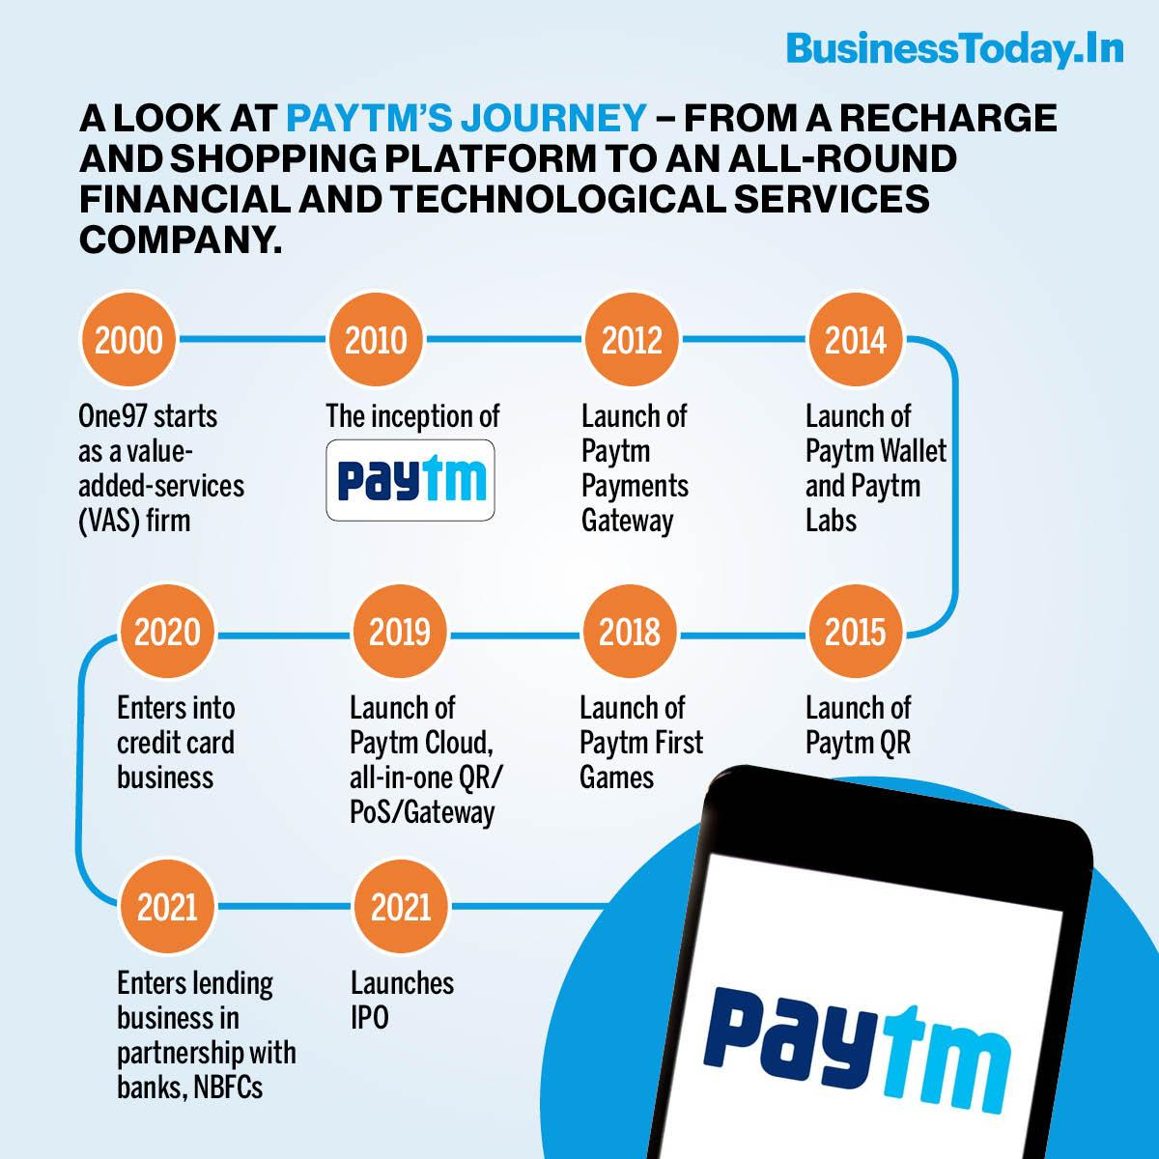
TIMELINE TRAJECTORY

Slide 6
COMPANY DETAILS
Reach
India, United States, Canada, UK, UAE
Strength
10001+
Annual Revenue
$1.0 Billion
Head office
India, Noida

Slide 7
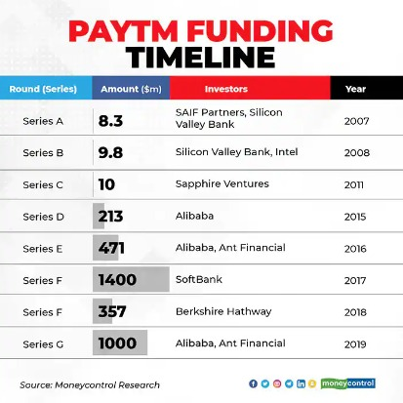
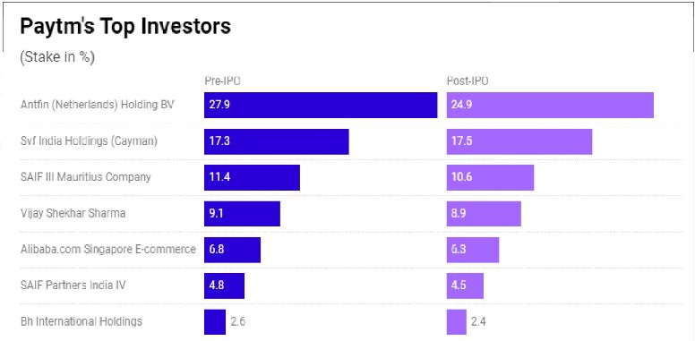
PAYTM INVESTORS

Slide 8
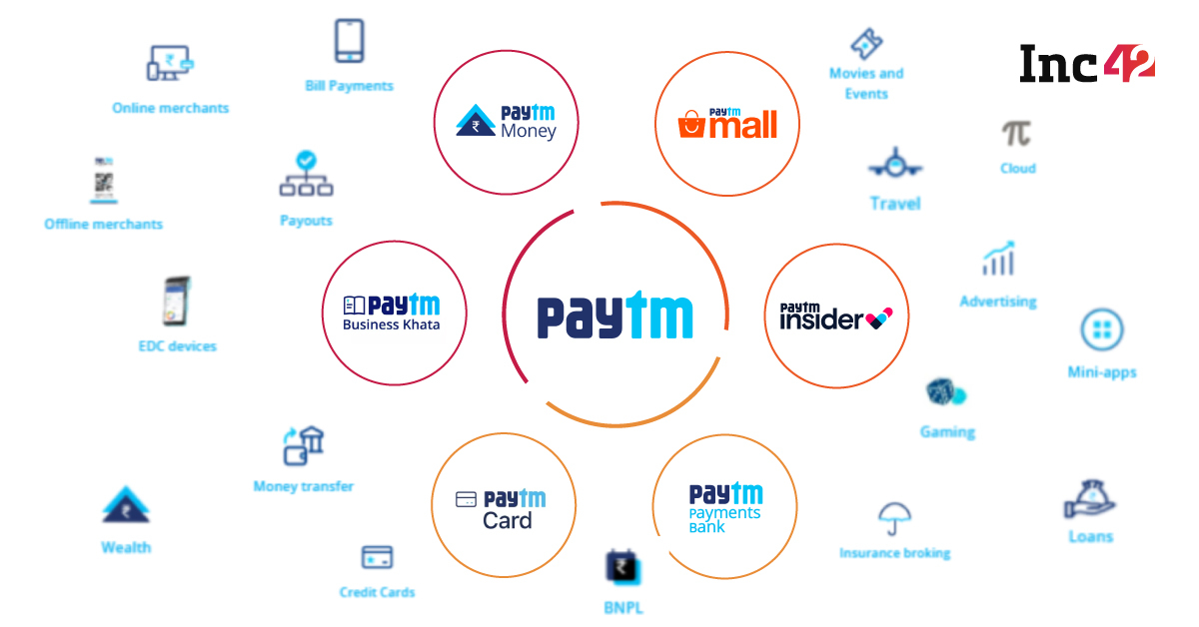
PRODUCTS & SERVICES

Slide 9
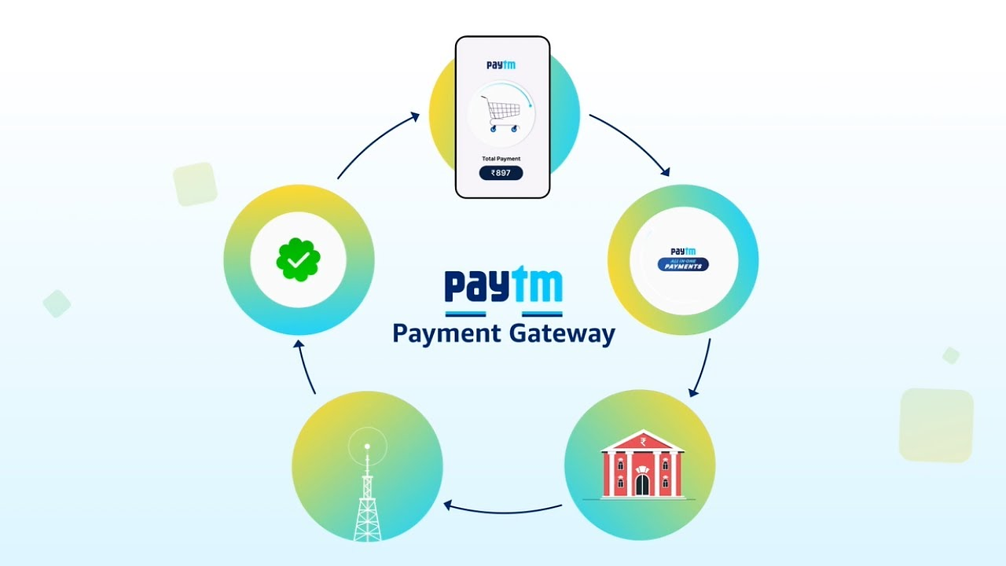
HOW PAYTM WORKS?

Slide 10
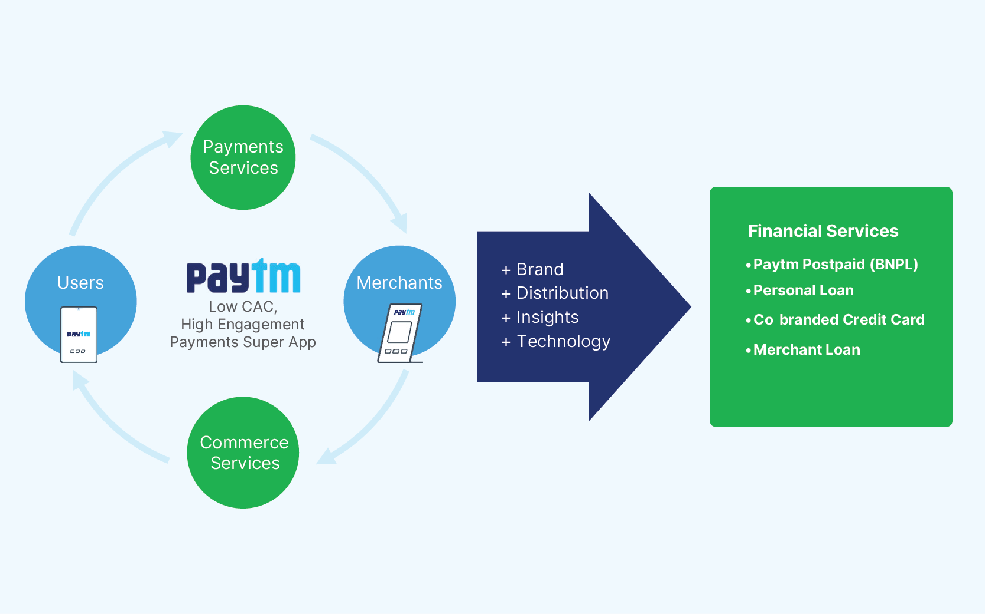
REVENUE MODEL

Slide 11
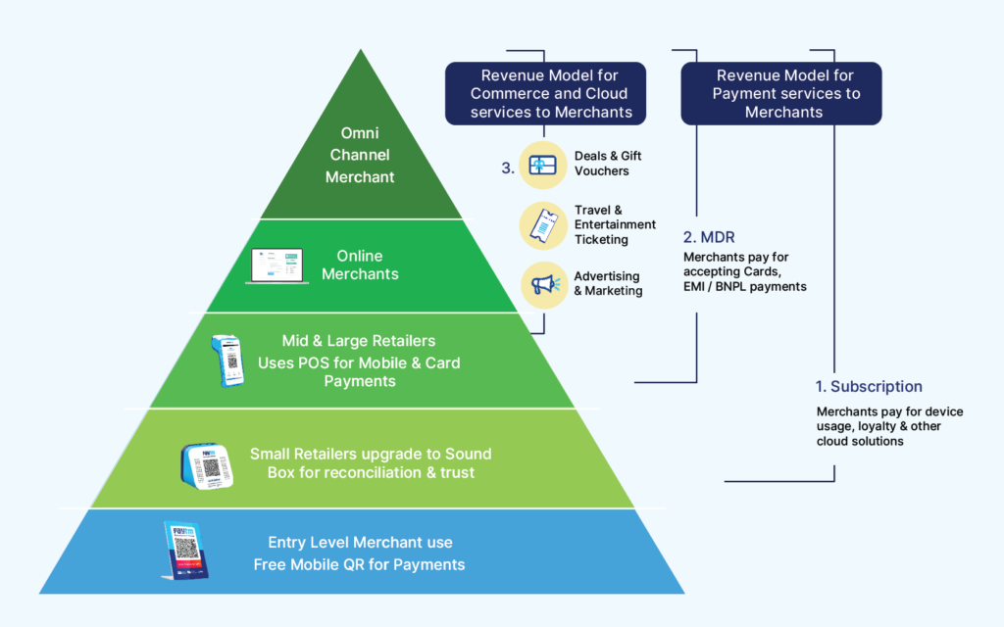
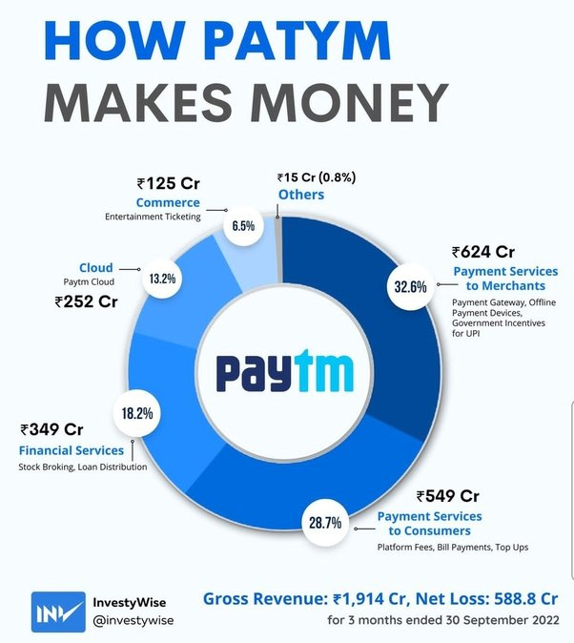
REVENUE MODEL

Slide 12
METRICS

Slide 13
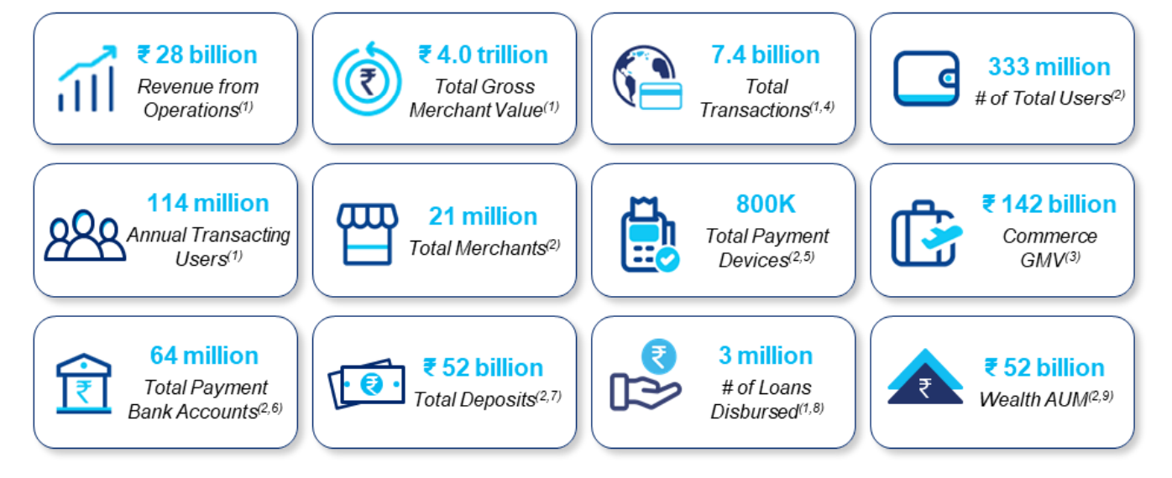
PAYTM GROWTH

Slide 14
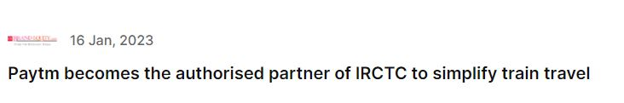
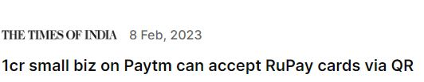
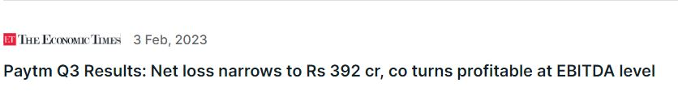
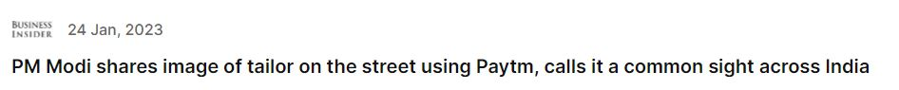
PAYTM IN MEDIA

Slide 15
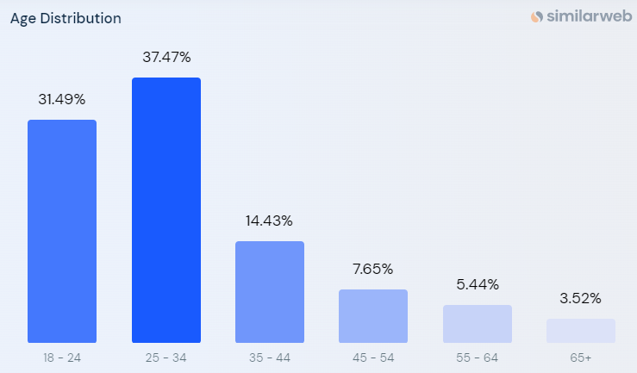
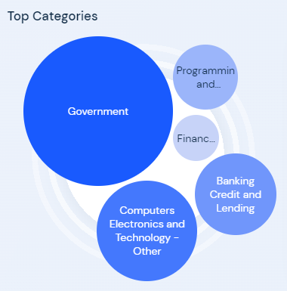
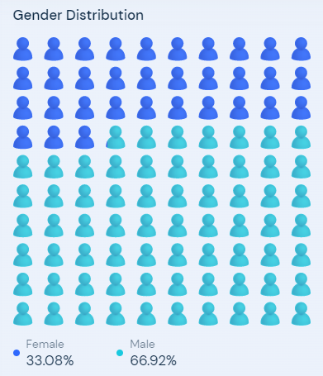
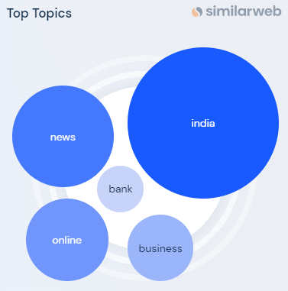
CUSTOMER DEMOGRAPHICS

Slide 16
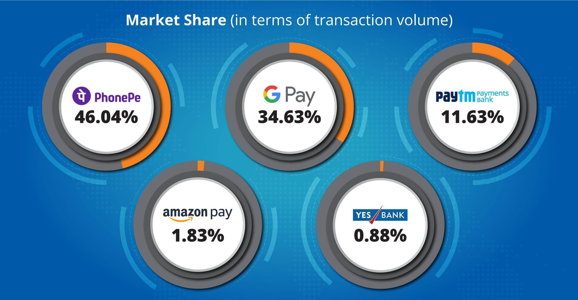
COMPETITORS

Slide 17



COMPETITORS

Slide 18
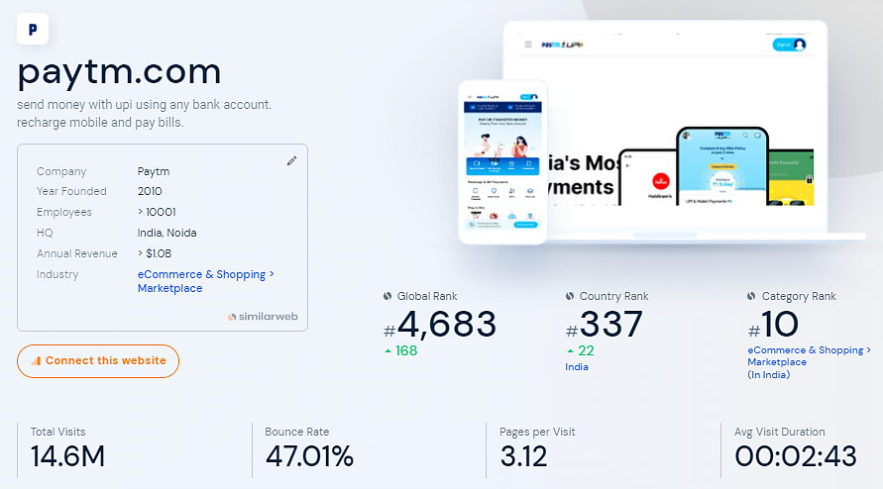
MARKET POSITION

Slide 19
PAYTM IN LOSSES
PRICE
PRICE TO SALES RATIO IS TOO HIGH
As of today, it's overall valuation is 113606.72 crores with a sales of 2600 crores. This means that Paytm is worth what it will be earning in 42.6 years.
SALE
COMPETITION FROM UPI APPS
For the last 4 years, the revenue has been stuck in 3000 crores per annum because of tough competition from phonePE, BharatPE and Google Pay. Even if they cut down all the promotional and marketing costs, the maximum revenue they can make is 3500 crores.

Slide 20
PAYTM IN LOSSES

Slide 21
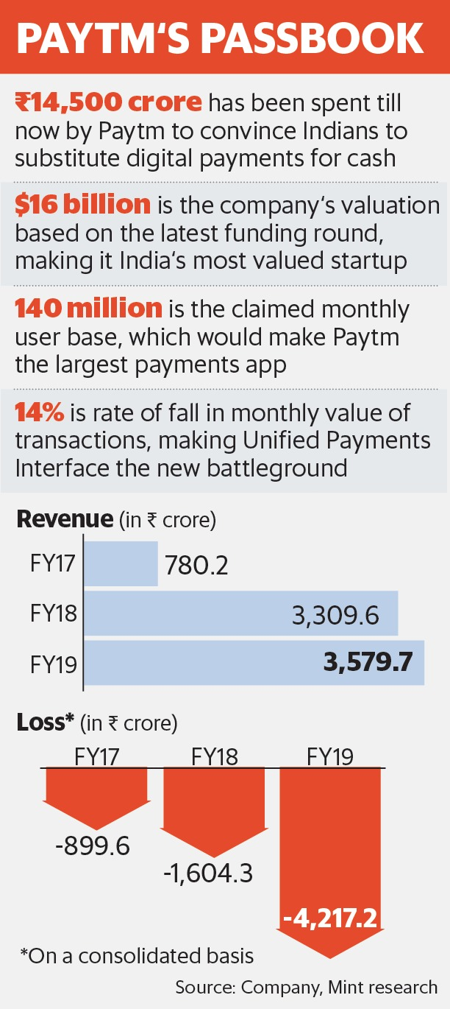
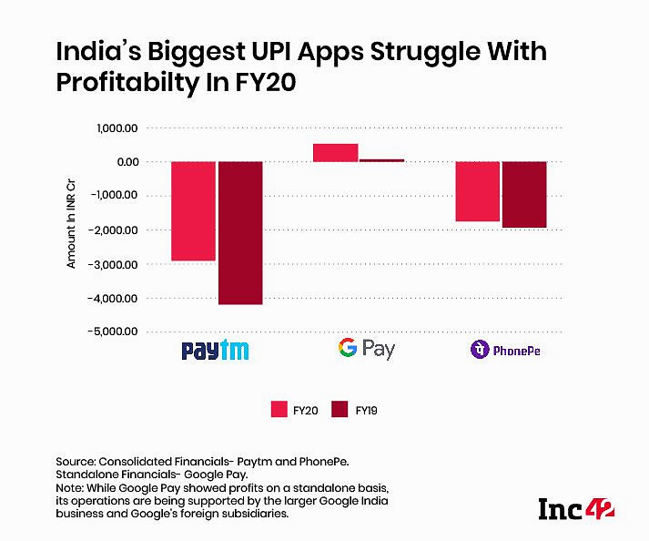
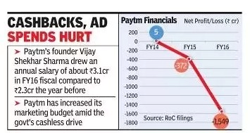
CHALLENGES FACED BY PAYTM

Slide 22
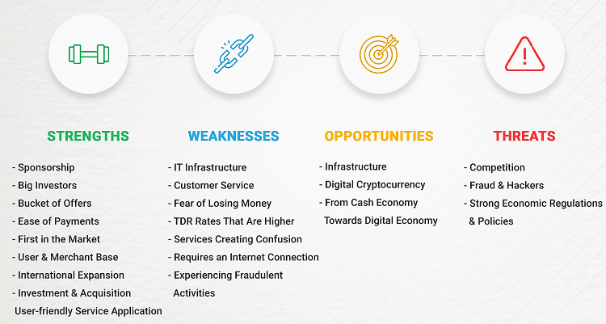
SWOT ANALYSIS OF PAYTM

Slide 23
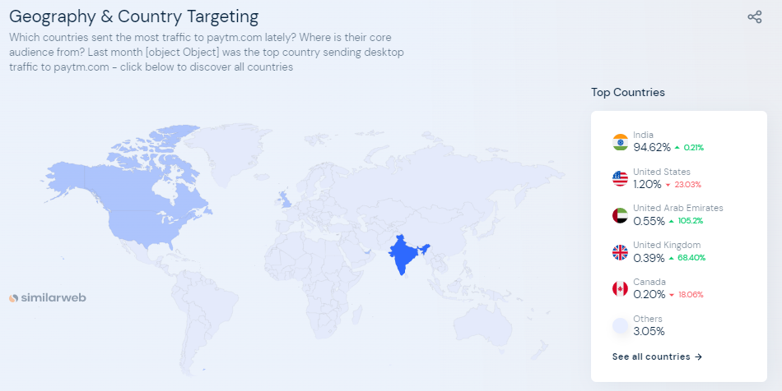
FUTURE SCOPE

Slide 24
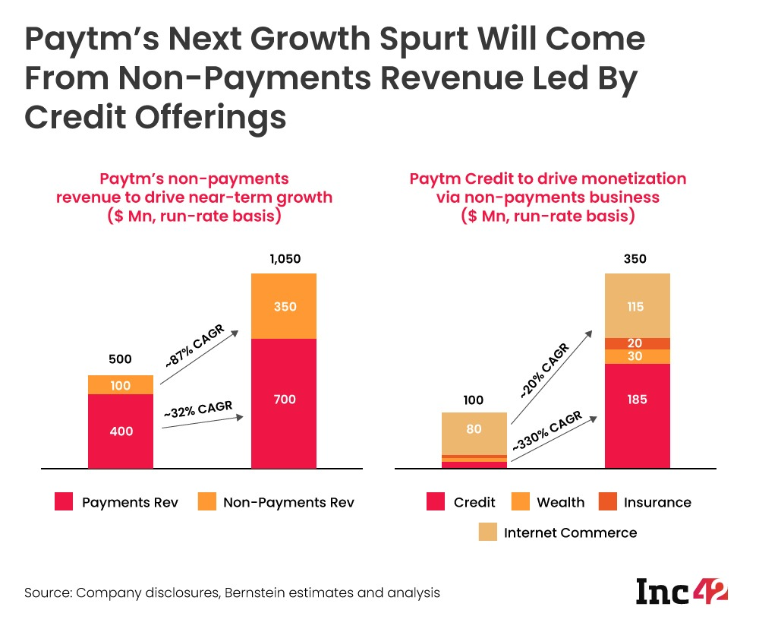
FOCUS ON FINANCIAL SERVICES

Slide 25
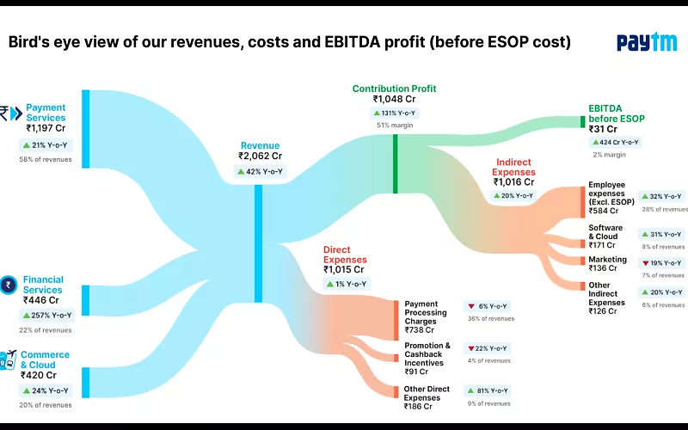
WHAT COULD BE DONE DIFFERENTLY?

Slide 26
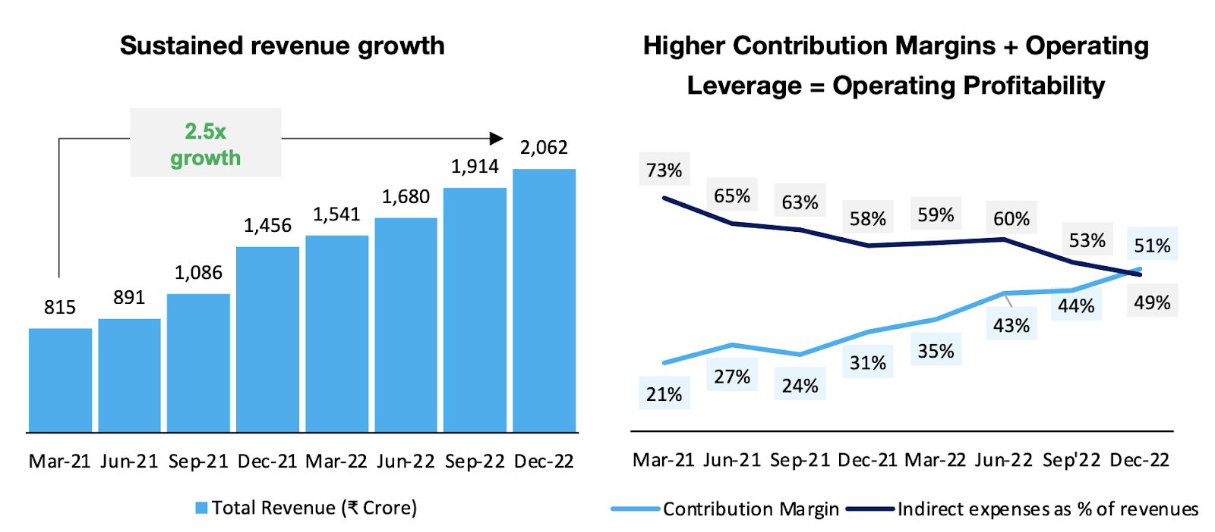
WHAT SHOULD BE THE APPROACH TO MAKE IT PROFITABLE?
INCREASE IN REVENUE
Paytm’s financial services, payments services and commerce and cloud services are three key businesses where the financial and payments sectors together contribute 75% of its revenues.
Paytm needs sustained revenue growth with better operating leverage leading to improved profitability.

Slide 27
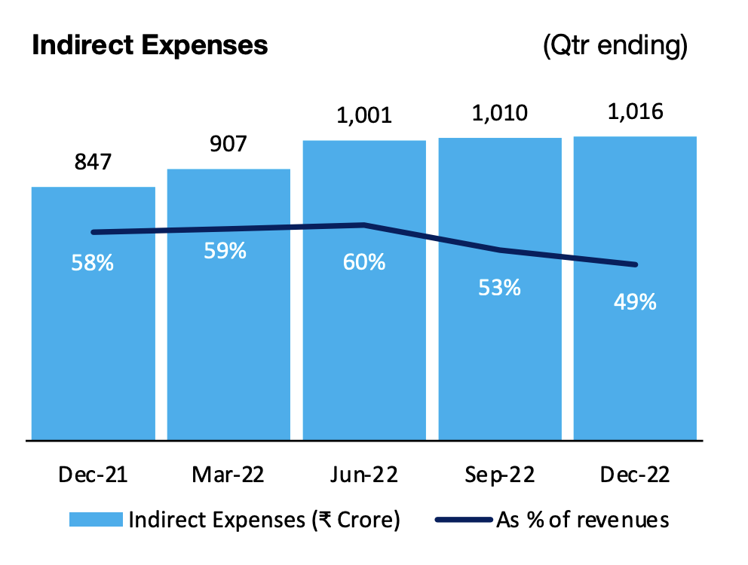
WHAT SHOULD BE THE APPROACH TO MAKE IT PROFITABLE?
DECREASE IN INDIRECT EXPENSES
Employees expenses, cloud & software and marketing are the major indirect expenses for Paytm.
Reduction in % of Indirect Expenses can help lower overall expense of Paytm resulting in reduction of losses and making it profitable in long run.

Slide 28
PAYTM SUCCESS FORMULA
DECREASE IN DIRECT & INDIRECT EXPENSE
INCREASE IN REVENUE & SUSTAINED GROWTH

Slide 29
THANK YOU!

